Slide 1
Head Start Annual Report
2019-2020
Darlington County Community Action Agency Created by: Diane McIver, Head Start Director & Program Coordinators
February 25, 2021

Slide 2

Head Start agencies that provide services to children and families must meet the Head Start Program Performance Standards and the requirements set forth in the Head Start Act.

Slide 3
Family Services Overview
The Family Services component consist of two content areas:
ERSEA (Enrollment, Recruitment, Selection, Eligibility, and Attendance)
Family Engagement

Slide 4

Enrollment Data Comparison
2018/2019 2019-2020
Transitioning /Returning Transitioning /Returning
115 / 185 113 / 186

Slide 5

Program Goal
To coordinate with Darlington County Department of Social Services to ensure that low income, homeless, and children in foster care are identified and enrolled.

Slide 6
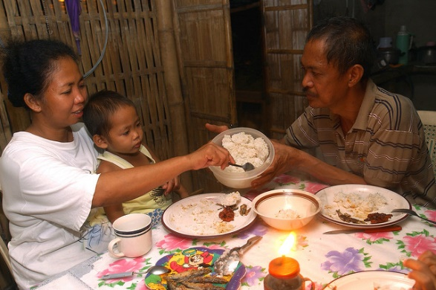

Slide 7

Race and Ethnicity
Primary Language
Primary Language
2018/2019 2019/2020
English: 323 English: 322
Spanish: 5 Spanish: 2
 | 2018/2019 | 2019/2020
American Indian or Alaska Native | 1 | 0
Caucasian | 13 | 16
African American | 302 | 284
Multi- Racial | 10 | 14
Hispanic /Latino | 2 | 10
Unspecified | 0 | 0

Slide 8
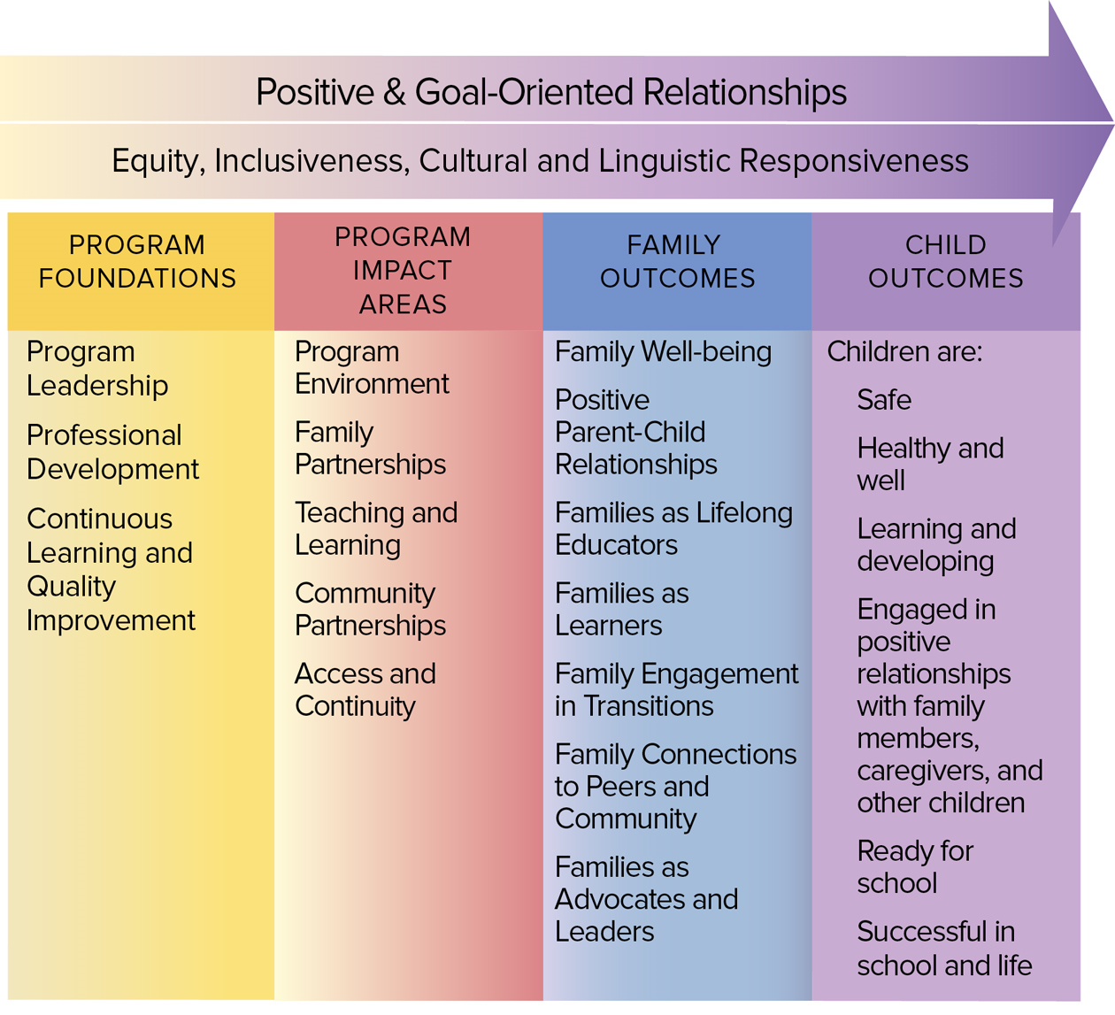
PFCE Framework

Slide 9
Partnership Agreement
FS and the parent establishes a partnership of the goals they have outline for their family to achieve. FS assist through seeking services and making referrals with community partners.
Services Received
2018/2019 2019/2020
198 130

Slide 10
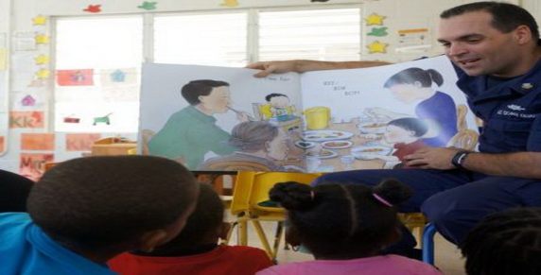
Father Engagement Services Received
2018/2019 2019/2020
Family Assessments 119 147
Family Goal Setting 93 148
Involved in Child’s Development 119 165
Head Start Program Governance 2 2
Parent Education Workshops 33 90

Slide 11

ReadyRosie
(Parent Engagement Curriculum)
ReadyRosie is an online resource designed for parents, which involves daily emails with videos, that coincide with classroom lessons. All Pre-K 4 Head Start families receive a free subscription to this fun and easy way to prepare children for a lifetime of learning

Slide 12
ReadyRosie Videos
Learning Outcome
Language and Literacy 375
Math 245
Social Emotional 199
Health and Well-Being 543
Family Outcome
Family Well-Being 206
Positive Parent-Child Relationships 454
Families as Lifelong Educators 435
Families as Learners 454
Family Engagement in Transition 28
Family Connection to Peers and Community 13
Families as Advocates and Leaders 0

Slide 13
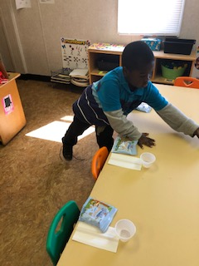
Health & Nutrition Services Overview
Program/School Readiness Goal
Enhanced on-going oversight, monitoring and Health and Safety training to ensure child safety.
Focus on the importance of providing children with nourishing food while at the centers and using opportunities to promote nutrition and healthy eating among families.

Slide 14
Health Statistics

Slide 15
Meals Served
Breakfast
Lunch
Snack
32,709
32,291
30,700

Slide 16
Medicaid
Private Insurance
Medical Coverage
298
26

Slide 17
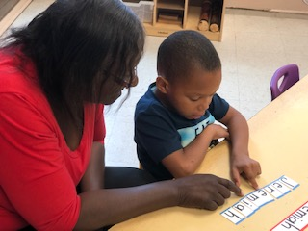
Education and Child Development Overview
Program / School Readiness Goals
To provide an early childhood educational environment that enhances children’s knowledge of language and culture, social/emotional skills, and healthy living, and ability to succeed in school and later life.
To strengthen the program curriculum within the areas of Math, Music, Science, Technology, Language and Literacy, that is supportive of both South Carolina and the Department of Health and Human Services (DHHS) concentration on School Readiness Goals

Slide 18
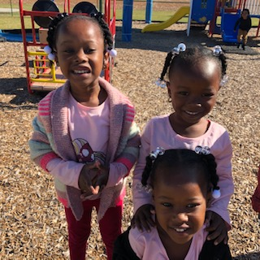
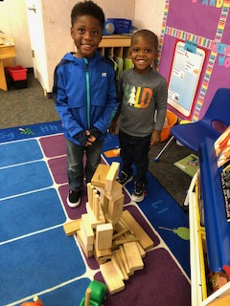
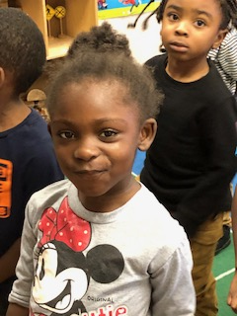
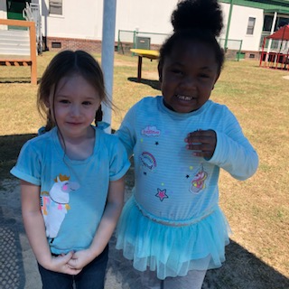


Our Children Are Our Greatest Resource

Slide 19
CLASS Scores
Darlington County 2019 Class Scores
Emotional Support | 6.02
Classroom Organization | 5.98
Instructional Support | 4.25
OHS CLASS® Descriptive Statistics, 2019 National Distribution of Grantee-Level Domain Scores
Domain | Lowest 10% |  | Median (50%) |  | Highest 10%
Emotional Support | 5.6875 |  | 6.08 |  | 6.38
Classroom Organization | 5.3241 |  | 5.82 |  | 6.17
Instructional Support | 2.3333 |  | 2.92 |  | 3.45
Notes:
National Recognition from OHS for high scores in Instructional Support.

Slide 20
Head Start Program Performance Standard 1302.14 (b) states "a program must ensure at least 10 percent of its total funded enrollment is filled by children eligible for services under IDEA.

Slide 21
Head Start Program Performance Standard 1302.91 (e)(2) & (3) states “a program must ensure all center-based teachers have at least an associate's or bachelor's degree in child development or early childhood education, equivalent coursework, or otherwise meet the requirements of section 648A(a)(3)(B) of the Act.
Teacher Qualifiations

Slide 22

School Readiness
The Head Start Approach to School Readiness means that children are ready for school, families are ready to support their children’s learning, and schools are ready for children
The five central domains (comprehensive) of child development are:
(1) Approaches to Learning
(2) Social and Emotional Development
(3) Language and Literacy
(4) Cognition
(5) Perceptual, Motor, and Physical Development.

Slide 23

Teaching Strategies Gold
 | Social Emotional | Physical | Language | Cognitive | Literacy | Mathematics
Fall 2019-2020 | 47.53% | 25.93% | 29.88% | 25.74% | 34.25% | 39.28%
Winter 2019-2020 | 91.36% | 72.74% | 76.28% | 76.28% | 79.83% | 75.81%
Spring 2019-2020 | 92.69% | 92.69% | 94.42% | 87.88% | 90.58% | 84.81%
End of the Year Gain | 45.16% | 66.76% | 64.54% | 62.14% | 56.33% | 45.43%
School Readiness Target 95% (285) | 95% | 95% | 95% | 95% | 95% | 95%

Slide 24
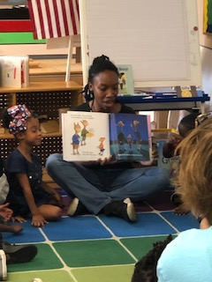
Phonological
Awareness
Literacy
Screening
“Alignment with School Readiness”
2020 End of Year PALS Results
(115Children Assessed)
 | Spring Developmental Range | Transitioning Children Average
Name Writing | 5-7 | 6
Uppercase Letters | 12-21 | 19
Lowercase Letters | 9-17 | 16
Letter Sounds | 4-8 | 13*
Beginning Sound Awareness | 5-8 | 6
Print and Word Awareness | 7-9 | 7
Rhyme Awareness | 5-7 | 6
Nursery Rhyme Awareness | 6-10 | 7

Slide 25
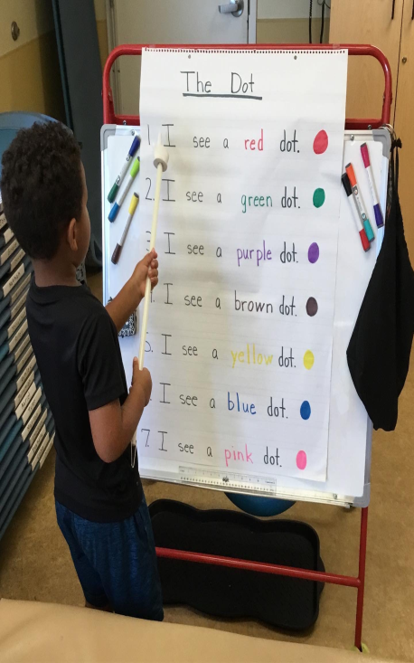
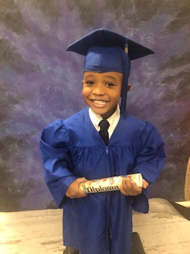
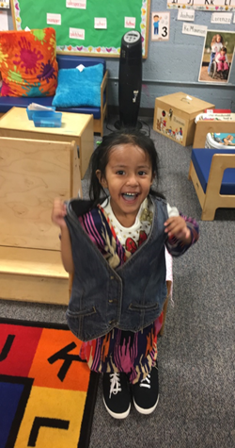
Ready for 5K!!

Slide 26

The End!

